Slide 1
Disease Prediction and Prevention using AI
Team Members:-
24dco01 - Ansari Saad
24dco02 - Ansari Ruaid
24dai09 - Shaikh Sahil

Slide 2

Disease Prediction and Prevention: A Python Approach
Welcome to our presentation on a revolutionary healthcare solution that leverages the power of AI to predict diseases and provide personalized prevention strategies.

Slide 3
Introduction: The Power of AI in Healthcare
Transforming Healthcare
Proactive Prevention
Artificial intelligence is revolutionizing healthcare, empowering doctors with data-driven insights and improving patient outcomes.
This system leverages AI to analyze patient symptoms and predict potential diseases, enabling early intervention and prevention.

Slide 4
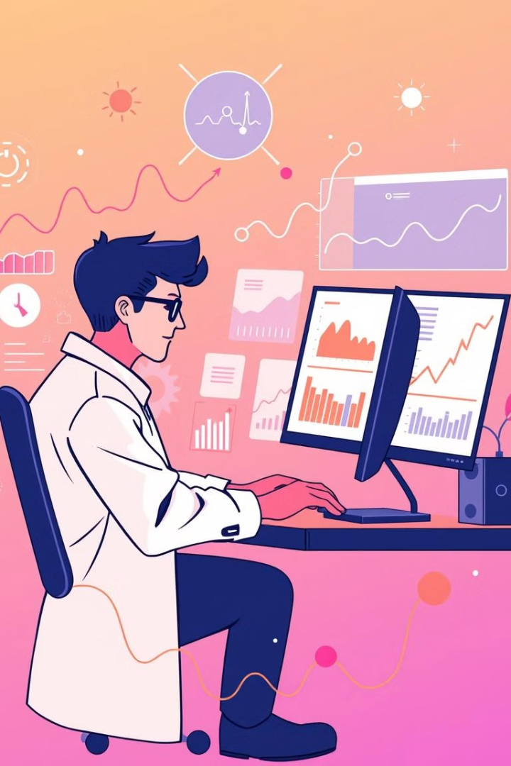
Data Collection and Feature Engineering
Symptom Data
Feature Engineering
We collect comprehensive symptom data from various reliable online sources to ensure high accuracy.
This data is then processed and transformed into meaningful features that can be used to train a machine learning model.
Data Cleaning
Cleaning the data is vital to ensure accuracy and reliability of our prediction model, removing inconsistencies and errors.

Slide 5

Building the Prediction Model with Python
Algorithm Selection
We choose a suitable machine learning algorithm based on the nature of the data and the prediction task. In this case Random Forest Generation.
Model Training
The model is trained on a large dataset of patient data, learning to identify patterns and predict potential diseases.
Model Evaluation
We rigorously evaluate the model's performance using various test cases to ensure accuracy and robustness.

Slide 6
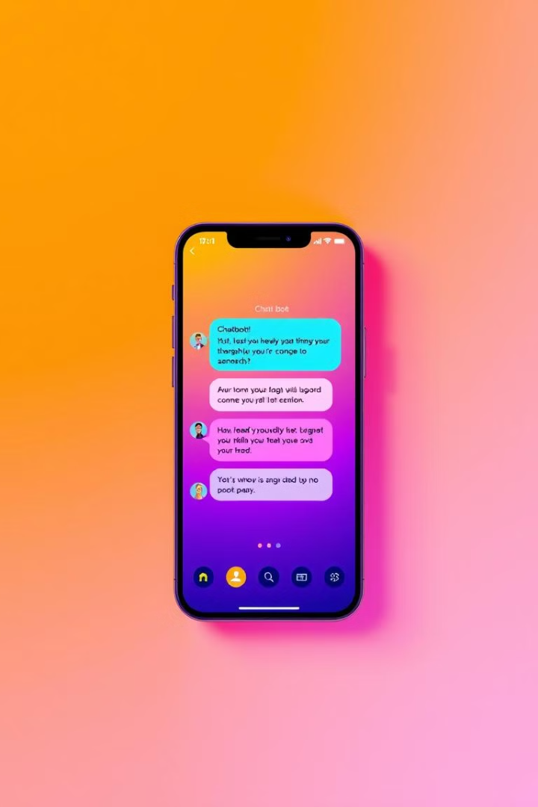



Developing the Interactive Chatbot Interface
A user-friendly chatbot interface is designed to guide users through the symptom assessment process.
The chatbot answers doubts of the user in a simple and understandable manner.
The chatbot provides a personalized and supportive experience, building trust and encouraging user engagement.

Slide 7
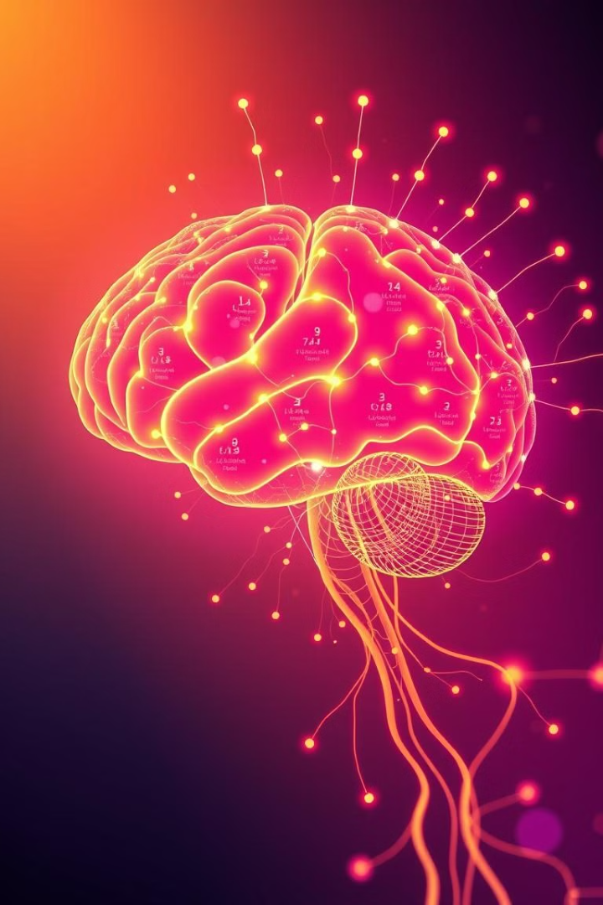
Real-Time Symptom Analysis and Disease Prediction
1
Symptom Input
The model collects user input about their symptoms, providing a comprehensive view of their health.
2
Data Processing
The collected data is processed and analyzed using the trained machine learning model to identify potential diseases.
3
Prediction Output
The program provides the user with a personalized disease prediction based on their symptom profile.

Slide 8

Conclusion: Empowering Patients with AI-Driven Insights
This innovative system empowers patients to take control of their health through early disease prediction and personalized prevention strategies.
AI-driven disease prediction empowers users with quick, reliable health insights.
Early detection helps in taking timely precautions and seeking proper care.
Personalized home remedies provide natural ways to manage symptoms.
AI chatbots enhance accessibility by answering health-related queries instantly.
Together, AI and healthcare innovation create a smarter, healthier future.

Slide 9
THANK YOU VERY MUCH!
We gained various valuable experiences during this ALGORITHM 9.0 and hope to grow our skills further.

